Slide 1
Swivel Chair Operation RTM and Quincus

Slide 2



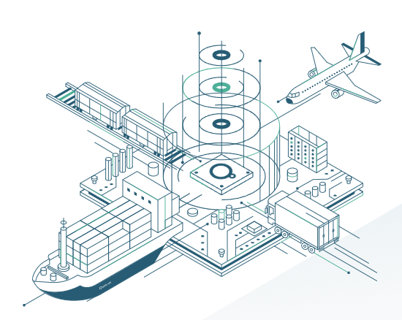
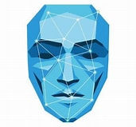
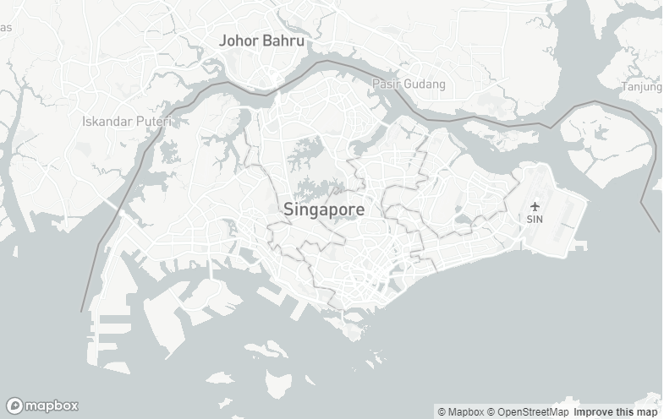
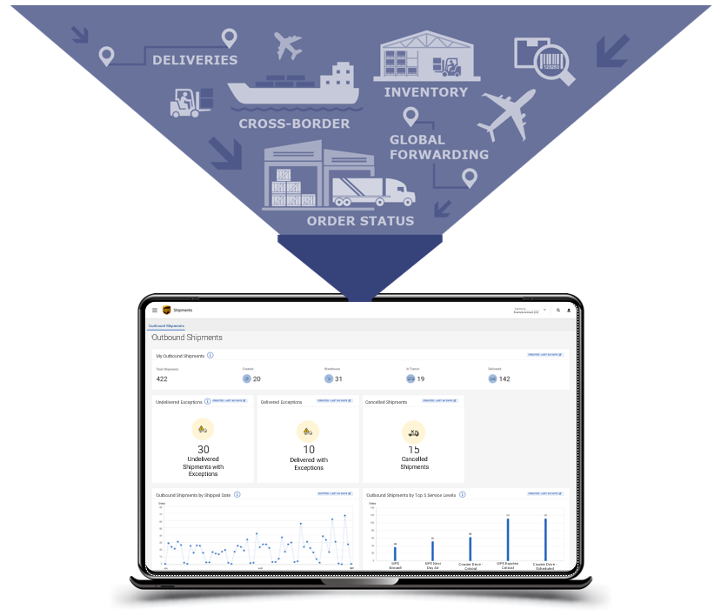
1
2
Pull and Upload into Quincus to facilitate dispatch activity
Received information from RTM and push into Quincus dispatch module and push to respective countries vendor
4
3
SPLUS/RTM
Received updates into RTM for completed orders
Draw information from Quincus like POD timestamp and push back to RTM periodically(Maps?)
UPS Symphony
5
Push information into Symphony to facilitate real time visibility, need to confirm how can maps be pulled and transfer
Provides GPS Real Time Visibility, GEO fencing, capability etc

